Slide 1
AUGUST 9TH & 10TH 2022 | 8:30am-4:00pm
THE CATHOLIC UNIVERSITY OF AMERICA
EDWARD J. PRYZBYLA UNIVERSITY CENTER
620 MICHIGAN AVE NE | WASHINGTON, DC 20064

Slide 2
Welcome

Slide 3
Soul Train
This Photo by Unknown Author is licensed under CC BY-NC-ND

Slide 4
SEL Opener
Reflect on your favorite thing about Out of School Time (afterschool, extra curricular activities, latch key kid)
What are some ways you ensure the experience you had is reflected in your work?

Slide 5
Workshop Sessions

Slide 6
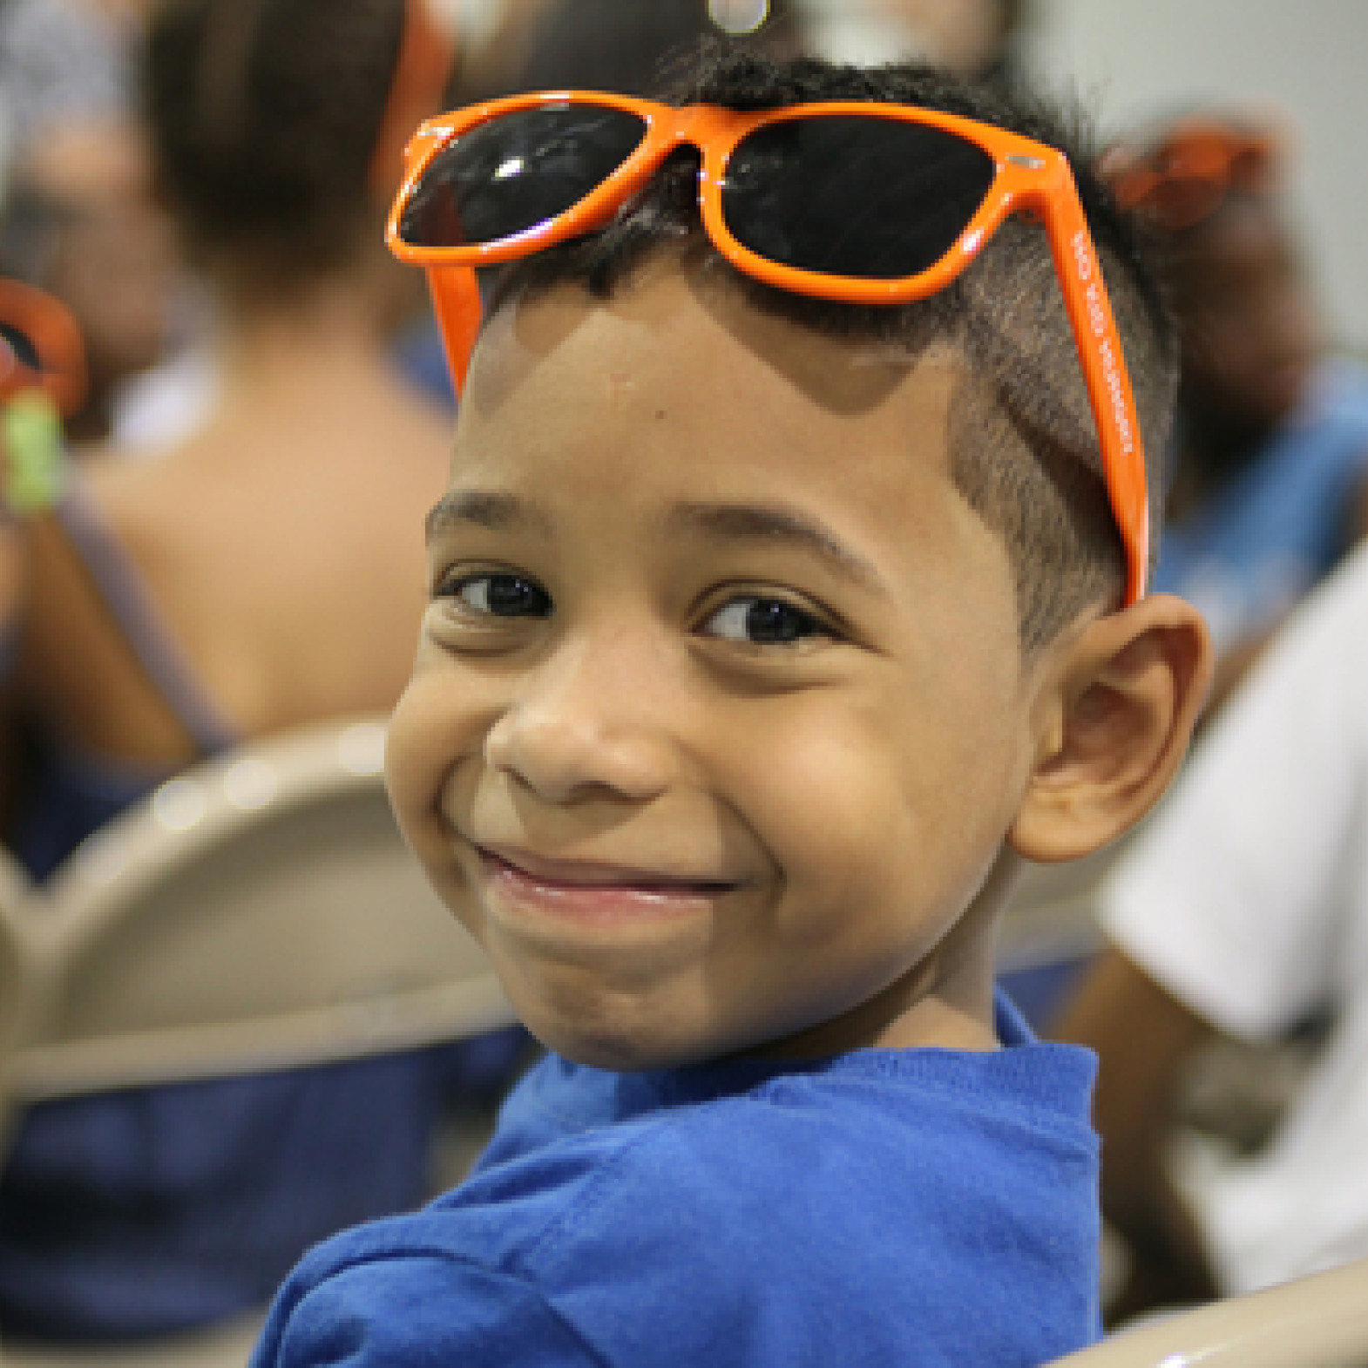
All Behavior Tells A Story
How do you define behavior?

Slide 7
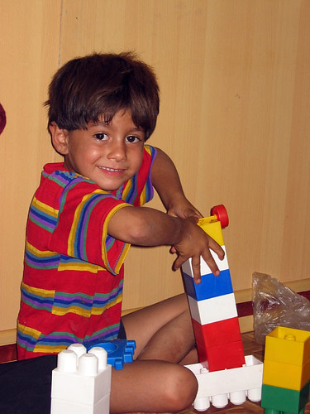
Meet Bruce

Slide 8
All Behavior Tells a Story
The Four Functions of Behavior
Sensory
Behavior that is internally pleasing, Not trying to get attention
Ex. Rocking back and forth
Escape/Avoidance
Trying to “get out of “ doing something
Ex. Elopement, throwing assignments away
Attention
Behavior that is seeking a reaction.
Ex. Yelling loudly, hey look at me
Tangible
Behavior that one is trying to obtain something or gain access to something.
Ex. Shouting until I get go outside.

Slide 9
All Behavior Tells a Story
What is being communicated if a student spits on you?​
I don't want you in my space....​
What is being communicated if a student runs out of the building?​
I don't feel safe here...​
What is being communicated if a student crawls in the ceiling?​
Closed in spaces make me feel comfortable​

Slide 10
What Causes These Types of Responses
Psychiatric
Neurological
Other Factors
Kahoot!

Slide 11
Phases of Acting Out

Slide 12
When Does De-escalatation Begin?

Slide 13
Conflict Cycle
Triggering Incident
Overwhelming Feelings
Impulsive Behavior
Negative Reactions

Slide 14
Conflict Cycle Example
Triggering Event- Bruce struggles with reading
Overwhelming Feelings – Staff gets frustrated every time the Bruce reads
Impulsive Behavior- Bruce leaves the classroom when its time for reading
Negative Reaction- Staff chases Bruce and tells him that he is disrupting the building is suspended

Slide 15
De-Escalation
Objectives
Minimize Crisis
Prevent Crisis

Slide 16
Reframe Our Language
Strategies for De-escalation
Help Strategy
Ask Bruce what does he need
Give 5-10 seconds to process
Ask again
Provide reasonable choice: Start the first problem or Take a one-minute break, then start your assignment

Slide 17
Reframe Our Language
Strategies for De-escalation
Prompt Strategy
Incompatible behaviors
Prompt something Bruce can do
Allow 5-10 seconds to process
Direct statements, not questions: Have a seat, Take a deep breath

Slide 18
Reframe Our Language
Strategies for De-escalation
WAIT Strategy- WHY AM I Talking
Monitor for safety
When Bruce is calm, switch to Help or Prompt strategy

Slide 19
Take Aways
De-escalation is not reactive
Behavior is communication
Establish relationships
De-escalation does not take 5 minutes

Slide 20
Thank you
Crystal Millington
Program Manager
crystal.millington@k12.dc.gov
2027315571

