Slide 1
Office of Chief Operating Officer
Divisions of School Operations and School Security
Ricky Brown, Dr. Jacqueline Speight & Lisa Couser, Presenters
Safety and Security
2022
District of Columbia Public Schools | 1200 First Street, NE | Washington, DC 20002 | T 202.442.5885 | F 202.442.5026 | dcps.dc.gov

Slide 2
Welcome
The goal is to provide you with an overview of emergency drills and protocols.
Schools have a duty to take care of their students, staff, and faculty. Most schools are very safe places—but for those unthinkable emergency instances, schools need to have a plan to respond.
Emergency preparedness drills will play a pivotal role in saving lives in a critical incident.

Slide 3
Emergency Planning, Response & Compliance Team (EPRC)
The vision of the EPRC Team is to ensure that DCPS possesses the capability necessary to protect against, prevent, prepare for, mitigate, respond to and recover from all hazards and threats. This includes identifying best practices and implementing a comprehensive training and exercises program.

Slide 4
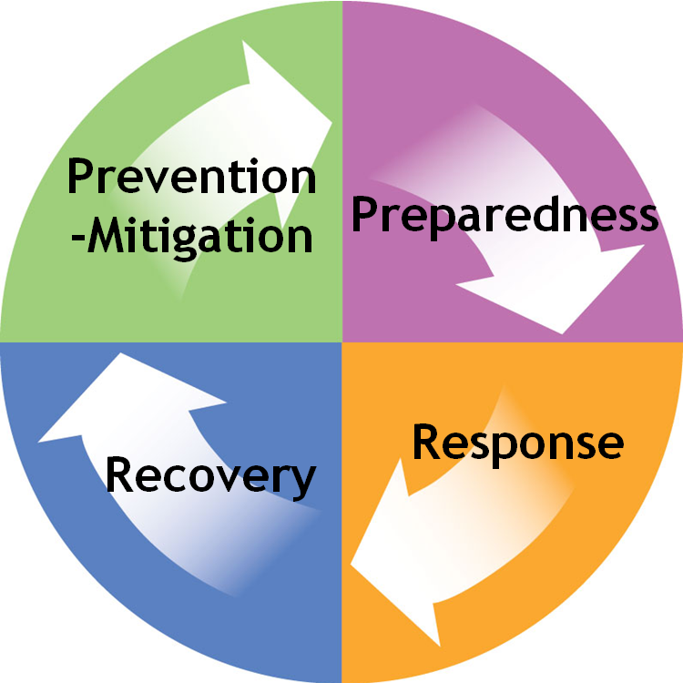
The Emergency Management Cycle
Prevention: The capabilities necessary to avoid, prevent imminent threats.
Mitigation: The capabilities necessary to reduce loss of life and property by lessening the impact of disasters.
Preparedness: The capabilities necessary to secure the homeland against acts of terrorism and manmade or natural disasters.
Response: The capabilities necessary to save lives, protect property and the environment, and meet basic human needs after an incident has occurred.
Recovery The capabilities necessary to assist communities affected by an incident to recover effectively.

Slide 5
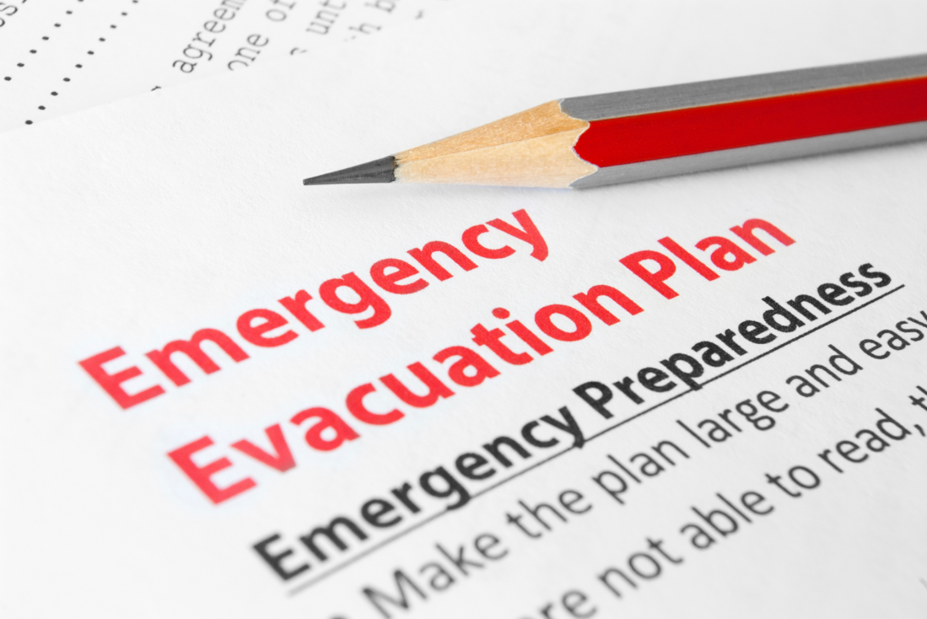
What is an Incident?
An incident is…
….an occurrence, caused by either human or natural phenomena, that requires action to prevent or minimize loss of life, or damage to property and/or the environment.
Notes:
Discuss Drills.
Should I stay or should I go diagram

Slide 6
Drills
Evacuation - Emergency conditions may dictate the relocation of building occupants to alternate locations. For example, fires, gas leaks, hazard chemical spills and releases within a building, and or bomb threats.
Reverse Evacuation - procedures are often implemented in combination with other procedures (e.g. lockdown, shelter-in-place) in order to ensure the safety of students and staff who are outside the building. When a Reverse Evacuation command is given, all students, faculty and staff that are outside should come inside the building quickly.
Notes:
Check for knowledge have participants give examples

Slide 7
Drills
Severe Weather - refers to any dangerous meteorological event with the potential to cause damage, serious social disruption, or loss of human life. Types of severe weather vary. High winds, hail, excessive precipitation, and wildfires are forms and effects of severe weather, as are thunderstorms, downbursts, lightning, and tornadoes. Seasonal severe weather events include blizzards, snowstorms, and or ice storms.
Shelter-in-Place - The use of a structure and its indoor atmosphere to temporarily separate individuals from a hazardous outdoor atmosphere. Close all windows, Seal gaps with wet towels, cover all openings to outdoors with plastic sheeting and tape.
Notes:
Check for knowledge have participants give examples
Improvise use costs, jackets or whatever materials you have availble
HESMA contact

Slide 8
Drills
Alert Status - This protocol applies to emergency conditions which require immediate secured access to the building(s). The incident dictates a heighten state of alert with visitors, deliveries, and others who desire access to the facility. Also, access by students and personnel, to outside areas such as sport fields, playgrounds, and court yards during the school day may be restricted.
Lockdown - A lockdown is an emergency protocol used to protect people inside a facility from a dangerous internal or external event. There are various levels of lockdown. For example, a partial lockdown means that the doors leading outside of the building are locked and people may not exit or enter the building. A full lockdown means that people must stay where they are and may not exit or enter a classroom or the building. If people are in a hallway they must go into the nearest classroom or office space. The goal is to place staff and students in a secured, concealed protective location as quickly as possible. The education process is stopped.

Slide 9
Lockdown Drill
What to Do:
Shelter any students or staff in your classroom/office.
Lock the door and windows.
Turn off lights.
Report IMPORTANT information via intercom or phone to office, if safe to do so.
Move students to out of sight (from door and windows) locations in room.
Keep quiet!
Note any staff/students not normally in your room.
DO NOT self-evacuate until area cleared by or directed by police or administrator.
Do not evacuate for a fire alarm unless there is fire or smoke, and you are in imminent danger.
DO NOT place window/glass covering over door, UNLESS CONCEALMENT CANNOT BE OBTAINED.
Should police enter your area: do not move, be quiet, and follow police commands.

Slide 10
Activity: Management Challenge
Instructions:
Identify what drill should be executed.
Identify the top (3) similarities and (3) differences for school personnel to manage this incident.
Identify one emergency planning and/or preparedness recommendation.
Stay alert you may be called upon to respond

Slide 11
Activity: Management Challenges
ALERT STATUS SCENARIO
As afterschool lead, you have been informed by a staff member that police activity is in the area. Law enforcement arrives and reports to school officials that there is no imminent danger at this time, but you should be on “Alert” as the level of activity may change and to be aware until the “all clear” is given.
Knowledge Check:
What do you need to know?
What do you need to do?
Who needs to be involved?
Notes:
Refer to the DCPS Filed Trip Packet in their resources

Slide 12
Activity: Management Challenges
Protocol:
Alert Status applies to emergency conditions which require immediate secured access to the building(s). The incident dictates a heighten state of alert to visitors, deliveries, and others who desire access to the facility. Also, this emergency situation restricts access by students and personnel, to outside areas such as sport fields, playgrounds, and court yards during the school day
Notes:
Refer to the DCPS Filed Trip Packet in their resources

Slide 13
Activity: Management Challenges
FIRE AND EXPLOSION SCENARIO
It is November, and a cold rain is falling. The temperature is 34 degrees, and the wind is blowing from the northwest at 18 miles per hour. At 5:00pm, the science area of Barack Obama Senior High School is rocked by an explosion. In less than a minute, the fire alarm sounds. For the most part, teachers begin an orderly evacuation but, because everyone knows that this time, it is not a drill, tensions are high, and some students begin pushing to get out.
Because no one had time to get their belongings—and because the school has a policy that prohibits the wearing of outdoor coats and hats in the classroom, students, teachers, and staff quickly become soaked.
Knowledge Check
What do you need to know?
What do you need to do?
Who needs to be involved?
Notes:
Refer to the DCPS Filed Trip Packet in their resources

Slide 14
Activity: Management Challenges
Protocol:
Evacuation - Emergency conditions may dictate the relocation of building occupants to alternate locations. For example, fires, gas leaks, hazard chemical spills and releases within a building, and or bomb threats.
Notes:
Refer to the DCPS Filed Trip Packet in their resources

Slide 15
Knowledge Check?
Discuss and explain the below DCPS emergency response protocols:
Lockdown
Alert Status
Shelter-in-Place
Severe Weather Safe Area
Evacuation Procedures
Reverse Evacuation

Slide 16
DCPS School Security Division

Slide 17
School Security Senior Director Ricky A. Brown Jr
School Security Division – Contract Security & DCPS Special Police Overview
DCPS School Police Michael Alston | Contract Security Michele Salahuddin Regina Waiters | Physical Security Franklin “Skip” Chrisman Mike Berry | Security Operations Lisa Couser Mary Johnson
DCPS Police Provide law enforcement support to schools Assisting with mediations Serving barring notices Monitor contract security Safe Passage Support | Contract Administration Building Use Agreements Post Orders Building Walkthroughs Contract Officer Deployment | CCTV Cameras and video footage X-Ray Machines Metal Detectors and Hand Wands Locks, Lighting and Fencing Intrusion Alarms in schools | Emergency Preparedness Budget Requisitions Receive and track Incident Reports Process Warning and Barring letters for delivery Manage Division Operations

Slide 18
Functions of School Security Division
School Security Division – Contract Security & DCPS Special Police Overview
School Security Contract Officer
Operations
Physical Security
DCPS Police Patrol Unit
Emergency Plain & Guidance
Notes:
*****ADD OPERATION SECTION

Slide 19
DCPS Contract Security
School Security Division – Contract Security & DCPS Special Police Overview
Security Assurance Mgmt.
School Officer (SO I & SO II)

Slide 20
Background and Context
School Security Division – Contract Security & DCPS Special Police Overview
2004
DC Council enacted the School Safety and Security Procedures Act of 2004
Delegating the sole contracting authority for security services at DCPS facilities from DCPS to MPD
MOU between DCPS and MPD
Summer 2020, contract shifted away from MPD to DCPS
Notes:
Doug
Helping everyone understand between the types of officers who serve our schools
DCPS is the client and we are responsible for developing security policy and standards in collaboration with MPD.
MPD controls the administrative process, including reviewing invoices submitted by contractor and processing payments, ensuring that all posts are covered, adding or deleting guard coverages, addressing DCPS Concerns with contractor and resolving any disputes with contractor.

Slide 21
Contract Officers Core Functions
School Security Division – Contract Security & DCPS Special Police Overview
Observe and report
Authority within and perimeters of buildings;
Patrol hallways, stairwells, and conduct perimeters checks;
Maintain a safe and secure environment conducive to learning;
Manage weapons abatement stations (Secondary Schools only);
Collaborate with school resource POC’s to de-escalate incidents;
Work in partnership with School Leadership, School Security, and MPD.

Slide 22
Post Orders
School Security Division – Contract Security & DCPS Special Overview
Similar Standard Operating Procedures (SOP’s) for Officers
Detailed information on officer's whereabouts
Determined by Principal or Designee
MUST be reviewed, approved, and signed by Principal or Designee
Copy of post orders should be kept at the school (officers' desk)

Slide 23
Incident Reporting
School Security Division – Contract Security & DCPS Special Police Overview
When incidents occur, follow district and school-based guidance;
Contract security should be notified IMMEDIATELY;
Contract Security Officers are REQUIRED to write incident reports;
All incident reports should be completed by EOD;
If MPD is involved, include Central Complaint Number (CCN#)*;
Scanned and emailed to School Security team;
Incident reports are legal documents and cannot be shared externally;
Notes:
IF NO CCN# PLEASE SEND ANYWAY
DCPS is the client and we are responsible for developing security policy and standards in collaboration with MPD.
MPD controls the administrative process, including reviewing invoices submitted by contractor and processing payments, ensuring that all posts are covered, adding or deleting guard coverages, addressing DCPS Concerns with contractor and resolving any disputes with contractor.

Slide 24
Contract Officers Support
School Security Division – Contract Security & DCPS Special Police Overview
ALL DCPS Activities
Before Care Programming
Regular Instructional School Day
After Care Programming
Special Activities
Athletic Events
Community Events

Slide 25
Requesting Security Support
School Security Division – Contract Security & DCPS Special Police Overview
All security requests
must be submitted at least…
7 business days prior to the event.

Slide 26
Contract Security Roles & Responsibilities
School Security Division – Contract Security & DCPS Special Police Overview
… During OST programming

Slide 27
Contract Officers should…
School Security Division – Contract Security & DCPS Special Police Overview
Observe and report
Follow their post orders
Safeguard students, staff, and DCPS property from any unlawful, harmful, or destructive activity
Provide immediate response for all incidents
Report incidents to the OSTP Afterschool Site Lead (or designee), School leader, DCPS Police, MPD and Security Assurance Management, Inc. (SAM) supervisor IMMEDIATELY!!!
Generate and complete incident reports in a timely manner
Remain on post until the last student has been picked up
Provide direct support to all afterschool activities that are held outside

Slide 28
Contract Officers should NOT…
School Security Division – Contract Security & DCPS Special Police Overview
Serve as the main POC to hand off students to parents
Be left alone with students at the front desk
Use their phones for long extended periods of time
Withhold information related to a school related incident
Leave their post before all students have left the building

Slide 29
Questions pertaining to Contract Security ? Contact Us!
School Security Division – Contract Security & DCPS Special Police Overview
Ms. Michele Salahuddin
Michele.Salahuddin@k12.dc.gov
Ms. Regina Waiters
Regina.Waiters@k12.dc.gov
Mr. Kalyn Blueitt
Kalyn.blueitt@k12.dc.gov
Mr. Ricky A. Brown, Jr.
Ricky.Brown@k12.dc.gov

Slide 30
DCPS School Special Police
School Security Division: School Special Police
Captain, Michael Alston Michael.Alston@k12.dc.gov
Command Center 202-576-6950

Slide 31
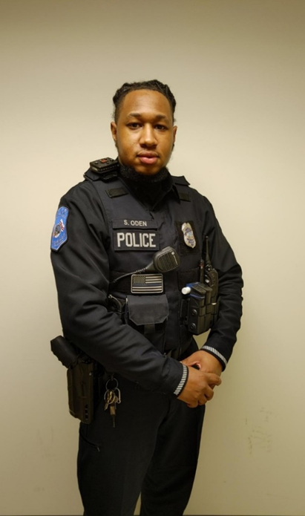
DCPS School Special Police
School Security Division – Contract Security & DCPS Special Police Overview

Slide 32
DCPS School Special Police
School Security Division – Contract Security & DCPS Special Police Overview
20 Officers
Commissioned by DCRA and MPD
Armed Special Police Officers – DC Government
Arrest Authority throughout DCPS Properties and Events
Certified Special Police Officers
DCPS Law Enforcement Officers
On duty 24/7/365

Slide 33
DCPS School Special Police
School Security Division – Contract Security & DCPS Special Police Overview
Supplement Contract Security Officers in schools and support MPD School Resource Officers with law enforcement and security related calls
Serve Barring Notices
Mediation Support
Safe Passage
Before Hours
After Hours

Slide 34
DCPS School Special Police
School Security Division – Contract Security & DCPS Special Police Overview
Locker Searches
Weapon Abatement
Training
Penetration Tests
Contract Compliance
Site visits
3 Certified Crisis Intervention Officers (MPD/DBH)

Slide 35
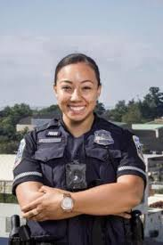
Partner Police Agencies
School Security Division – Contract Security & DCPS Special Police Overview
Metropolitan Police Department (MPD)
Metro Transit Police Department (MTPD)
MPD School Resource Officer (SRO)
MTPD School Resource Officer (SRO)

Slide 36
School Closing Protocols
School Security Division – Contract Security & DCPS Special Police Overview
Conduct an interior check, two (2) hours prior to closing building
Check all doors and windows
Arm the intrusion detection system (IDS)
Notify the command center prior to leaving
Ensure that all closing parties exit out of one identified door.

Slide 37
DCPS SPECIAL POLICE RESPONSE
School Security Division – Contract Security & DCPS Special Police Overview
Crisis Intervention
Physical Altercations with Injuries
Mediations
Special Attention Requests
Safe Passage Concerns
Barring Notice Service
Alarm Response/Issues
Community Events
Athletic Events
Community Meetings
School Building Vandalism
Daily School opening and closing
School closing/opening assistance

Slide 38
When to call 911, 311 or Command Center
School Security Division – Contract Security & DCPS Special Police Overview
911 is to be use for EMERGENCIES ONLY
- Crime in progress
- All fire and Medical
311 is to be used for NON-EMERGENCIES
- Text NEW or MENUE to 32311 (DC311)
Command Center: 202-576-6950
- Whenever you call 911 0r 311

Slide 39
Thank you! Questions?
School Security Division – Contract Security & DCPS Special Police Overview
Command Center (202) 576-6950
Michael Alston, Captain: Michael.alston@k12.dc.gov
Corneilus Johnson, SPO: Corneilus.johnson@k12.dc.gov
Ricky A. Brown, Jr., Sr. Director: Ricky.brown@k12.dc.gov

