Slide 1
AUGUST 9TH & 10TH 2022 | 8:30am-4:00pm
THE CATHOLIC UNIVERSITY OF AMERICA
EDWARD J. PRYZBYLA UNIVERSITY CENTER
620 MICHIGAN AVE NE | WASHINGTON, DC 20064

Slide 2
OSTP
Enrichment
Curriculum Guide

Slide 3
WHO? Paraprofessionals and Teachers covering hours after Academic Power Hour from 4:30 pm to 6:00 pm
WHAT? Social Emotional Learning Activities
WHEN? Everyday!
WHERE? Assigned grade level classroom or other adequate space
WHY? We need to meet our grant objective of 75% of regular program attendees will show improvement from ​Fall to Spring in classroom behavior and attentiveness.
HOW? Dedication and Creativity!

Slide 4
Reflections, Gratitude and Purpose
With the changes prompted by a worldwide pandemic, children now more than ever need social emotional support. We have created this guide to ensure students have daily SEL activities that can help them learn life skills, character development and coping skills.
Additionally, the pandemic has created unprecedented staffing challenges. We honor and appreciate all the staff who have dedicated additional time and resources to students during out of school time hours. To assist with the transition from a sometimes challenging day, we also hope the preplanned activities will take away the additional need for planning afterschool lessons. With so many teachers stepping in to help in the program, we also wanted to ensure they could get an overview of our monthly themed activities.
Due to the nature of being a grant funded program, we do have to ensure fidelity in the structure and quality of our program especially as it pertains to what is written in the grant. In order to stay in compliance, we do need to have daily SEL activities take place during afterschool.

Slide 5
21CCLC OBJECTIVES
The DCPS 21st CCLC grant has a set of objectives related
to ​the outcomes we achieve:
90% average daily attendance in PK-Grade5 and ​75% in Grades 6-8.
​​40% of regular program attendees will make gains in ​classroom grades from fall to spring.
​10% of regular program attendees will increase at least one ​proficiency level on ELA and math state assessments.​
75% of regular program attendees will show improvement from ​Fall to Spring in classroom behavior and attentiveness.​
A cumulative of 60% of student program participants' family ​members will attend at least three program events as measured ​by attendance logs and surveys.

Slide 6
Did you Know?
Studies show that all it takes is 1 consistent, positive adult in a child's life to build resilience, that can allow them to overcome trauma and other life obstacles. Please be that adult; with positive words, positive actions and a positive mindset.

Slide 7
ENRICHEMENT THEMES August: Goal Setting September: Character October: Anti-Bullying November: Gratitude December: Kindness January: Diversity February: Financial Literacy March: Wellness April: STEM May: Community Service June: Joy

Slide 8
SEL RESOURCES FOR CHARACTER DEVELOPMENT

Slide 9
CHARACTER COUNTS! Is a framework that utilizes six pillars of character:​​
​​​
Trustworthiness​​
Respect​​
Responsibility​​
Fairness​​
Caring​​
Citizenship ​​
​​This framework promotes a focus on positive school climate, intensive decision-making strategies, mindfulness, growth mindset and behavioral change theories. ​
We will use the following resources as a part of our curriculum guide: The Good Ideas book, Today Counts 5-minute lessons and the​, Way to go Workbook​

Slide 10
For the Diversity theme, we will include lessons from the Anti-Bias Building Blocks Curriculum
For the Financial Literacy theme, we will use lessons from the Money Smart Curriculum that was created by the FDIC.

Slide 11
OSTP ENRICHMENT HOUR SCHEDULE

Slide 12
The Enrichment Hour for the OSTP afterschool Program will follow a 20/20/20 model like Academic Power Hour. ​
Daily Schedule for most sites:​​
3:30-4:30 Academic Power Hour​​
4:30-5:00 Supper​​
5:00-6:00 Enrichment Hour​​
Enrichment Hour Schedule​​
20 minutes: Afternoon Meeting ​​
20 minutes: Enrichment Curriculum Activity
20 minutes: Physical Fitness activity

Slide 13
AFTERNOON MEETING

Slide 14
The afternoon meeting can be facilitated using the “Today Counts!” Flip books which contains short character development discussions.​ Another idea is to have a question of the day related to the​ monthly theme. The facilitator can pick the question or a student.
The class can sit in a circle or other preferred method and start with an icebreaker or other mindfulness activity for students to reflect on their day, the students can discussion the question of the day.
The afternoon meeting will be an opportunity for students to transition from ​the Academic Power Hour into the Social Emotional Learning activities.

Slide 15
Afternoon Meeting Facilitation Example
1 minute: Transition into seating
1 minute: Whole group greeting​​
1 minutes: Group and individual expectations for the day​​
2 minutes: Reflect on yesterday’s topic​
2 minutes: Overview of today’s topic/plan​​
2 minutes: Read Today Counts! discussion/question of the day
3 minutes: Students share out answers to questions​​
7 minutes mindfulness/team building game​​
1 minute: Transition to learning space for enrichment lesson​​
​

Slide 16
ENRICHMENT LESSON

Slide 17
Lessons should be completed in the time given. The lesson should not be continued the next day unless otherwise stated in lesson/
activity.
Each month there is activities/lessons that follow a particular theme. Afterschool staff should implement provided lesson according to the schedule. ​
Afterschool staff should have materials, handouts and other items needed for the lesson already prepped and ready for the start of the Enrichment Hour.​​
When the Enrichment program is observed by Central Office Coordinators or external evaluators, they should be able to look at the calendar for that day of the month and see the lesson/activity listed being implemented.​​

Slide 18
PHYSICAL ​ FITNESS

Slide 19
Examples of physical fitness activities will be in the physical fitness section of the binder. There will be additional resources in the Enrichment curriculum binder that can also be used such as, ABC Yoga and The Back Pocket Games.
Facilitation:
Afterschool paraprofessionals will implement daily physical fitness activities after the enrichment lesson. ​
​​Afterschool staff should model the physical fitness activity for the students, they can also choose a student to model the activity for the class.

Slide 20
ENRICHMENT CURRICULUM BINDER ​ OVERVIEW

Slide 21
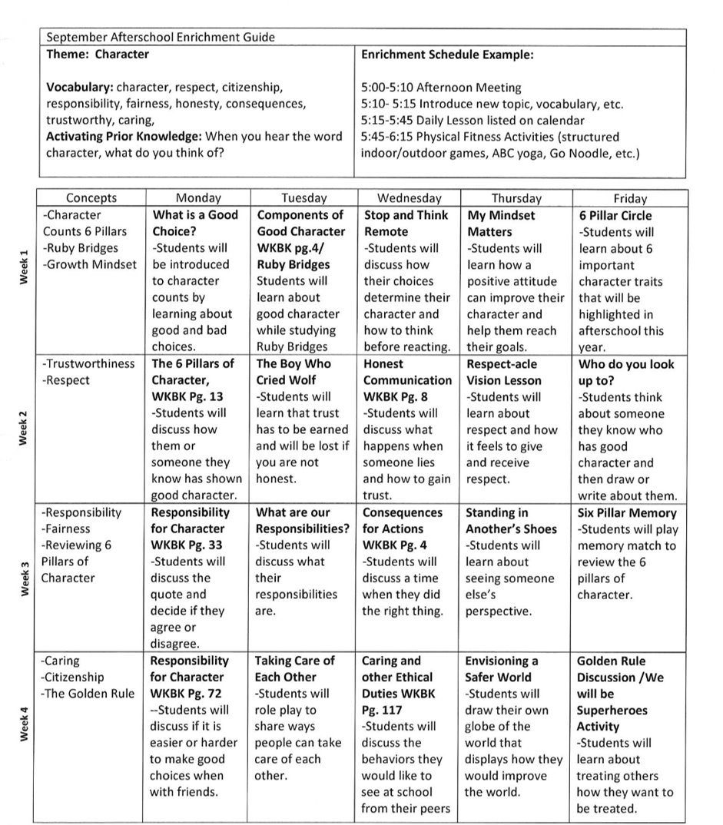
Monthly Schedule

Slide 22
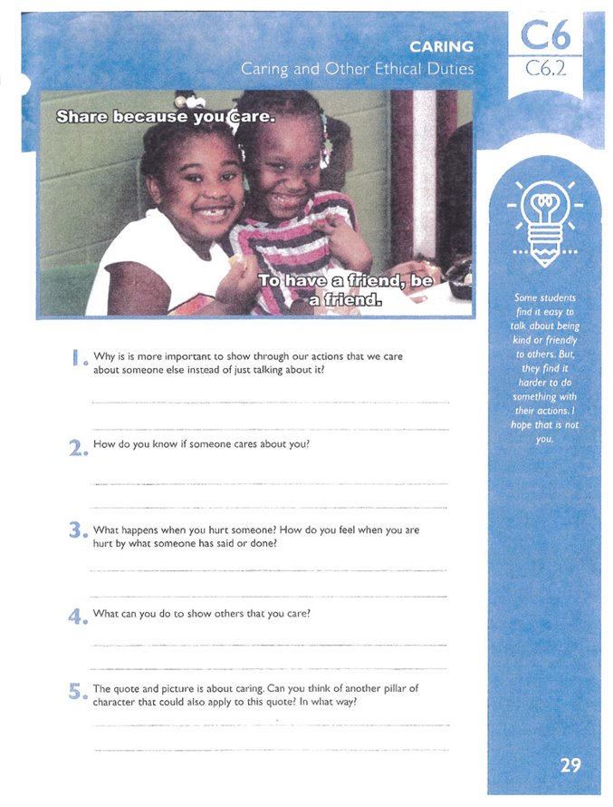
CURRICULUM ACTIVITY EXAMPLE 1
​The Way to go Workbook is a part of the Character Counts Curriculum. You may see this abbreviated in the curriculum document as WTGW with the page number.​​
This page can be copied for each student.​​
The afterschool staff will read the quote and discuss it with the class using the questions listed.​
This page should be used to facilitate a whole group discussion and then each student should answer the questions individually. After each student personally reflects on their answers, the whole group will come back together to share out their answers and feelings.

Slide 23
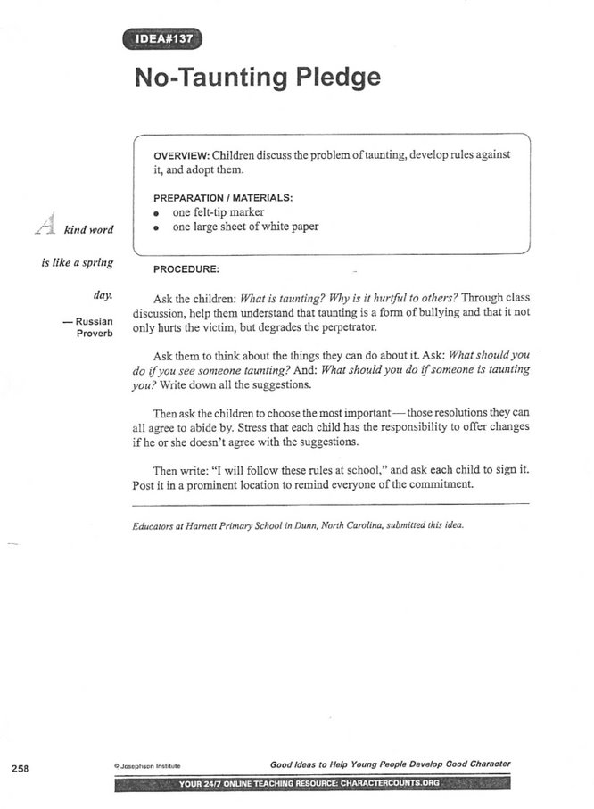
CURRICULUM ACTIVITY EXAMPLE 2
This is an example of the layout of a Character Counts Lesson​
This lesson plan gives you an overview of the topic, materials needed and the procedure on how to implement the lesson.​
Some of the lessons will come with additional handouts that may need to be copied for each student.

Slide 24
ENRICHMENT CURRICULUM ADDITIONAL DETAILS

Slide 25
All activities can be modified for different age levels.​ We will also be piloting an SEL curriculum for ECE students.
Extension activities are included for months that have extended breaks (Thanksgiving, Winter Break, etc.), that can be utilized if the scheduled days off change.​
Additional Physical Fitness activities will be included at the end of the Enrichment Curriculum Binder​.​
Each day a new activity or lesson will be expected, the previous day’s lesson should not be carried over to the next day unless otherwise indicated on the schedule.
We all know, kids love a good movie day, however, we cannot stream movies daily in afterschool. If a site would like to have a movie night, it will need to be a preplanned event with notices sent home to parents so they can decide if they would like to opt out.

