Slide 1
AUGUST 8TH & 9TH 2023
8:30am - 4:00pm
THE CATHOLIC UNIVERSITY OF AMERICA
EDWARD J. PRYZBYLA UNIVERSITY CENTER
620 MICHIGAN AVE NE | WASHINGTON, DC 20064

Slide 2
On the Mark, RESET, Go

Slide 3
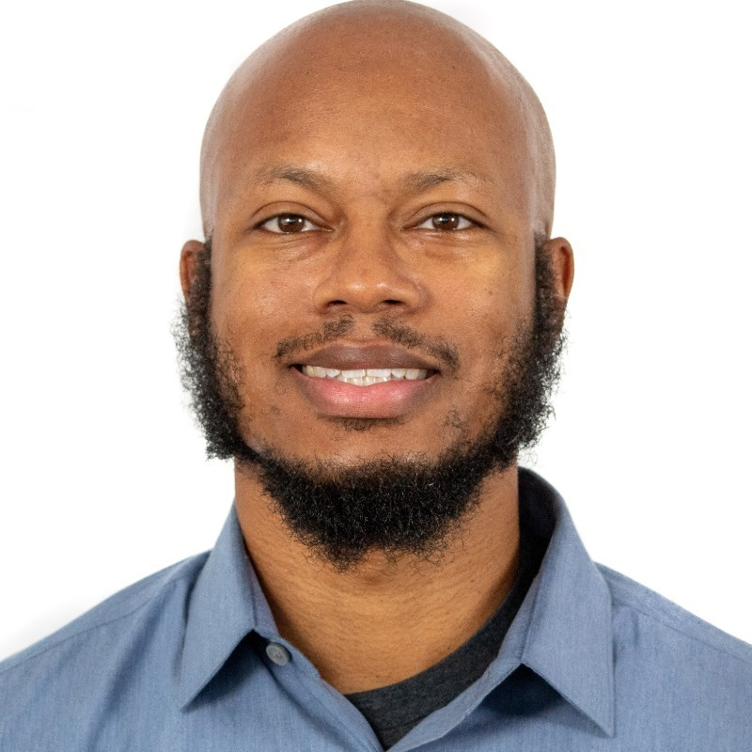
Presented By
Michael Posey
Lifelong Educator (9 yrs in classroom, 10 admin)
Lifelong Mover (10 national tournament titles)
ECE parent
National PE presenter

Slide 4
The Science of Movement
Movement is management; they don’t have to be mutually exclusive
The more you have, the more you’re prepared
K.I.S.S. when it comes to ECE
Easy to align with monthly themes

Slide 5
Let’s Move

Slide 6
Active Learning
Prepositions (Using builders and dozers game)
  Moving Over vs Moving Under
  In Front Of vs Behind
  On the Left vs On the Right
Dance, Dance, Name that
  Cabbage Patch
  Sprinkler
  Swimmer
  Lawnmower

Slide 7
SEL (without them even knowing)
Player/Caddy Shuffle
  Teach taking turns and sharing
  Allows students movement and responsibility
  Can be modified for larger sizes
Life on the Ice
  Shows importance of nonverbal communication
  Develops communication skills and strategy

Slide 8
What Makes You Move
Create space for students (circle, two lines)
Color of spot/chair determines who moves
Find matching color in the open space, name a fruit or vegetable and continue to dance (or locomotor movement) until music stops
Alternate colors, categories (fruits vs veggies)

Slide 9
Supermarket Sweep
Just like game show
Use locomotor skills to move about and “shop”
Pre-set total of spending
Set nutritional or plate guidelines for monthly theme

Slide 10
Thank you for your time

Slide 11
Checkout these activities and more at
OPENphysed.org

