Slide 1






DCPS Afterschool Programs 2023
EQUITY:
Do You SEE Me?
Dr. William L. Blake

Slide 2


Today's Agenda
  Discuss the State of EQUITY for Educators
  Design the student Equity Experience

Slide 3

What does EQUITY mean to You?

Slide 4
EDUCATORS
STUDENTS
HISTORY
are under ATTACK!

Slide 5
SUPREME COURT
AP African American History
Violation of CROWN ACT
Elimination of DEI in School

Slide 6
The following states have some form of censorship around equity:
  Alabama, Florida & South Dakota -Gender & Sexuality
  Florida - DEI Trainings (Higher Ed)
  Arkansas, California & Mississippi - Critical Race Theory
  South Dakota & Virginia - Civil Rights
  Tennessee - DEI Trainings (Higher Ed)
  Texas - DEI (Higher Ed)

Slide 7
The following states have passed policy to infuse equity in schools
  Colorodo - History classes must include contributions of diverse ethnicities & subgroups
  Nevada - Must teach contributions of LGBTQ, Native & Indegious & people of minority subgroups
  New Jersey - Include DEI in core content curriculum
  New Mexico - Include culturally responsive standards

Slide 8


VERY IMPORTANT
Students MUST have Culturally Responsive Programming to ensure:
  Their identities SHOW up in School
  They feel LOVED, VALUED & SEEN
  They feel SAFE & INCLUDED
  They have humans that LOOK & SOUND like them with Experiences

Slide 9
Practicing EQUITY
- Muslim Female Student who participate in Ramadan
- African American LGBTQ Male Student
- Mexican Immigrant Student
- Transgender Female Student
- Hispanic Student with Autism
- Asian American Student with Dyslexia
- African American female student with mental disorder

Slide 10

RESEARCH

Slide 11
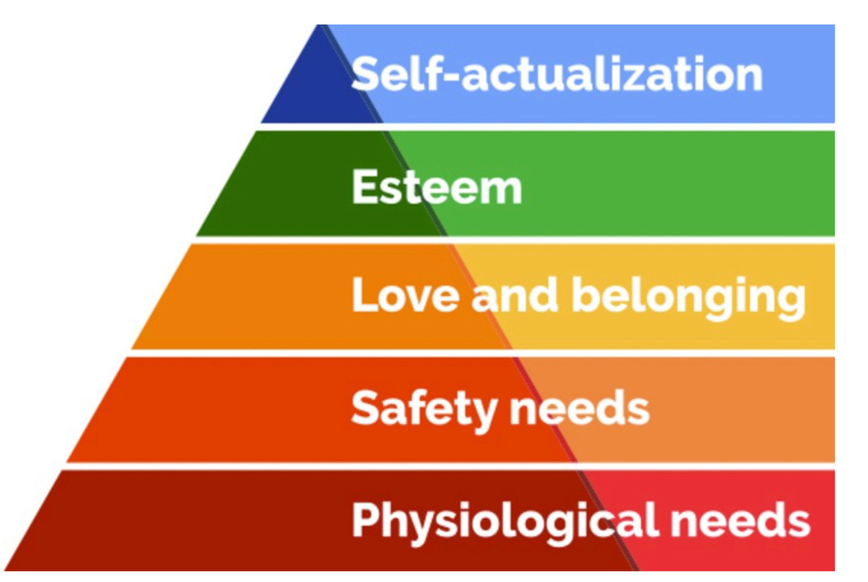

Design an Equity Experience
Identify your student BASIC Needs (Maslow) - How will you provide those needs in your afterschool programming?
What images will you use in your programming that represents their social norms?
How will you encourage the remaining of your students to accept & affirm your assigned students beliefs and/or lifestyle?

Slide 12
Thank you for committing to EQUITY

Slide 13
Stay Engaged
Cell -(202) 674-1716
Twitter: @TheKoolestDoc
IG: @Doctor_Kool
Email: Willblake05@gmail.com

