Slide 1
School Security Division: Contract Security , DCPS Police, and Physical Security Overview July 2023

Slide 2
School Security Division (SSD)
School Security Division
The SSD is responsible for the safety and security of all DCPS students, staff, school grounds and school property, including central office and warehouse locations.

Slide 3
Mission
School Security Division
The School Security Division (SSD) is responsible for the safety and security of all DCPS students, staff, buildings, public spaces and property. A safe school, promotes a healthy learning environment - where teachers can teach, Principals can lead, and students can learn and enjoy a rich academic experience.

Slide 4
School Security Division Ricky A. Brown, Jr. Sr. Director, School Security
School Security Division
DCPS Police Capt. Michael Alston Lt. Ronald Bogues Lt. B. Johnson Lt. C. Johnson | Contract Security Kalyn Blueitt Michele Salahuddin Pamela Floyd | Physical Security Franklin “Skip” Chrisman Michael “Mike” Berry | Security Operations Lisa Couser Mary Johnson
DCPS Police Provide law enforcement support to schools Assisting with mediations Serving barring notices Monitor contract security Safe Passage Support | Contract Management and Oversight Building Use Agreements Post Orders Building Walkthroughs Contract Officer Deployment Security Requests | CCTV Cameras and video footage X-Ray Machines Metal Detectors and Hand Wands Locks, Lighting and Fencing Intrusion Alarms in schools | Receive and track Incident Reports Respond to requests for incident reports Process Warning and Barring letters for delivery Manage Division Operations Budget and Fiscal Operations

Slide 5
Objectives for the Session
School Security Division
DCPS School Security
Participants will be able to:
become familiar with the School Security Division
define Security in our Schools
understand the “why” behind Contract Security
call out the role of Contract Officers in DCPS
outline the steps for incident reporting and making timely notifications
Recognize the importance of DCPS Special Police

Slide 6
Functions of School Security Division
School Security Division
School Security Contract Officer
Operations
Physical Security
DCPS Police Patrol Unit
Emergency Plain & Guidance
Notes:
*****ADD OPERATION SECTION

Slide 7
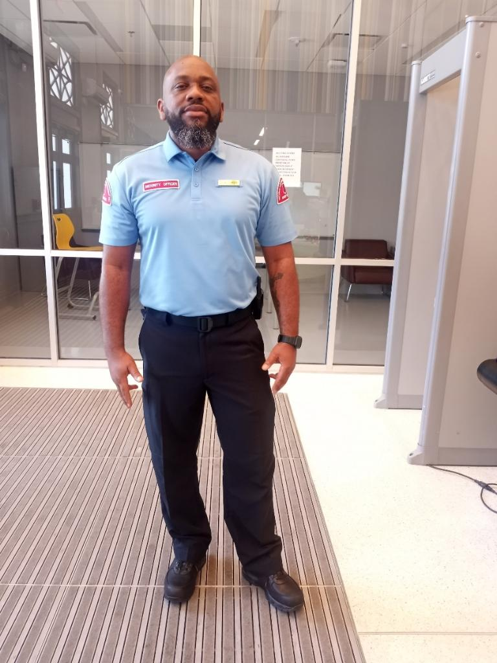
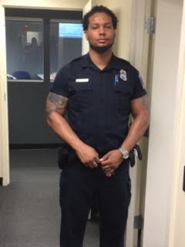
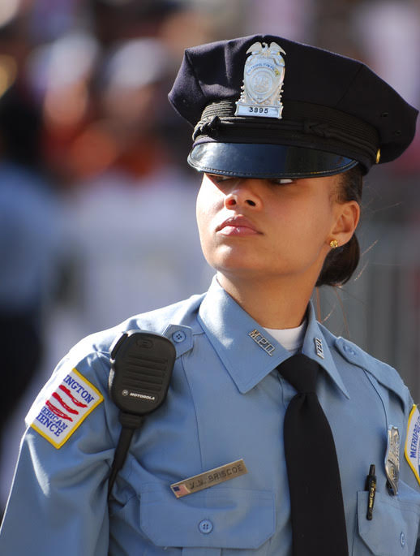
Defining Security in our Schools
School Security Division
Security Assurance Mgmt.
DCPS School Security Team
Metropolitan Police Department (MPD)
Contract School Officer
(SO I & SO II)
DCPS Special Police Officer (SPO)
School Resource Officer (SRO)
Notes:
Let the record show… they are not all the same
Doug
Helping everyone understand between the types of officers who serve our schools
DCPS is the client and we are responsible for developing security policy and standards in collaboration with MPD.
MPD controls the administrative process, including reviewing invoices submitted by contractor and processing payments, ensuring that all posts are covered, adding or deleting guard coverages, addressing DCPS Concerns with contractor and resolving any disputes with contractor.

Slide 8
School Security Division
Types of Officers | Officer Duties & Responsibilities
DCPS Special Police Officers (SPO) Members of the DCPS Police team are also known as Special Police Officers (SPOs), that provide general law enforcement duties to promote a safe environment. DCPS SPO’s are trained Crisis Intervention Officers (CIO) and work closely with schools to maintain close relationships with administrators, school-based staff, students, and parents. | DCPS SPO duties: Handle general law enforcement duties for DCPS; Respond to emergencies and critical level incidents within and around schools, rove/patrol DCPS locations; Monitor security contract compliance in schools, and report issues; Manage DCPS Command Center, alarm activations, CCTV camera systems, emergency calls, intrusion and fire alarms; Collaborate with other law enforcement agencies on behalf of DCPS; Supports emergency planning and drills; Assist with city-wide Safe Passage efforts; Authorized to detain and make arrests. `
Contract Security Officers (CSOs) Contract Security Officers are commonly referred to as either an SO (Guard I) or SPO (Guard II). Contract Officers are deployed to all DCPS school buildings. These individuals are contracted out by a security vendor and managed by DCPS’ School Security Division, Contract Security & Training team. Contract officers are school based and support school leaders, school-based staff, etc., to ensure the overall safety and security of all students and DCPS buildings. Since 2017, Contract Officers have been employed by Security Assurance Management (SAM). | CSO duties: • Observe and report all unusual and suspicious activities; • Conduct security patrols within and around school buildings; • Rove, patrol, and monitor common spaces, hallways, stairwells, restrooms, entrances, exits, and perimeter of buildings - as prescribed in CSO’s post-orders; • Conduct entrance screenings for all students (Secondary only), DCPS visitors and guests to ensure buildings remain free of weapons and contraband; • Manage DCPS visitor management protocols - to include 100% ID checks and visitor sign-in; • Supports schools through incident response and prepares incident reports; • Break-up fights and de-escalate verbal and physical altercations; • Provide security coverage at athletic and school-based events; • Contract Officers should work in partnership with Student Supports and Student Behaviors school-based staff.
School Resource Officers (SROs) School Resource Officers (SROs) are Police Officers, employed by the Metropolitan Police Department (MPD), who are trained to work with students in grades K-12. SROs are also Crisis Intervention Officers (CIO) and provide direct support to DCPS and D.C Public Charter Schools (DCPCS). Officers are deployed according to a “cluster model”. Lastly, SROs are a part of the School & Safety Division (SSD), which is housed in the Youth and Family Engagement Bureau (YEFB). | SRO duties: • Respond to critical emergencies within and around school buildings; • Build and maintain positive relationships with school leaders, students, and school-based staff; • Conduct daily check-ins with secondary schools for DCPS and DC Public Charter Schools (DCPCS); • Participate in School Safety Committee meetings; • Support athletics and large-scale community events and special activities; • Assist with Safe Passage, Safe Route city-wide programming • Conduct home visits • SRO’s have arresting power and make arrests when necessary
Notes:
Highlight three layers of security
We are very fortunate in this regard, talking to some of our charter friends, they don’t have the funding of resources so they only depend on MPD

Slide 9
Background and Context
School Security Division
2004… What happened?
DC Council enacted the School Safety and Security Procedures Act of 2004
Delegating the sole contracting authority for security services at DCPS facilities from DCPS to MPD
MOU between DCPS and MPD
Summer 2020, contract shifted away from MPD to DCPS
DCPS has complete oversight of Security
Notes:
Doug
Helping everyone understand between the types of officers who serve our schools
DCPS is the client and we are responsible for developing security policy and standards in collaboration with MPD.
MPD controls the administrative process, including reviewing invoices submitted by contractor and processing payments, ensuring that all posts are covered, adding or deleting guard coverages, addressing DCPS Concerns with contractor and resolving any disputes with contractor.

Slide 10
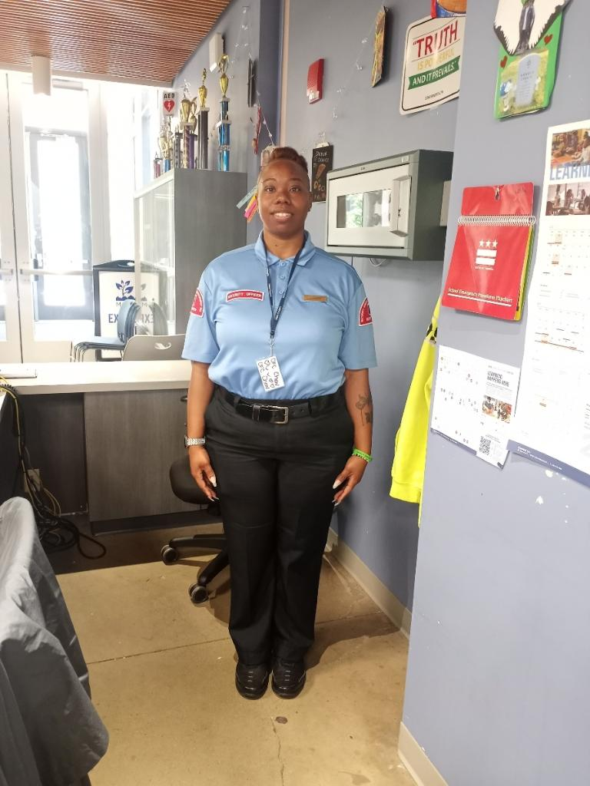
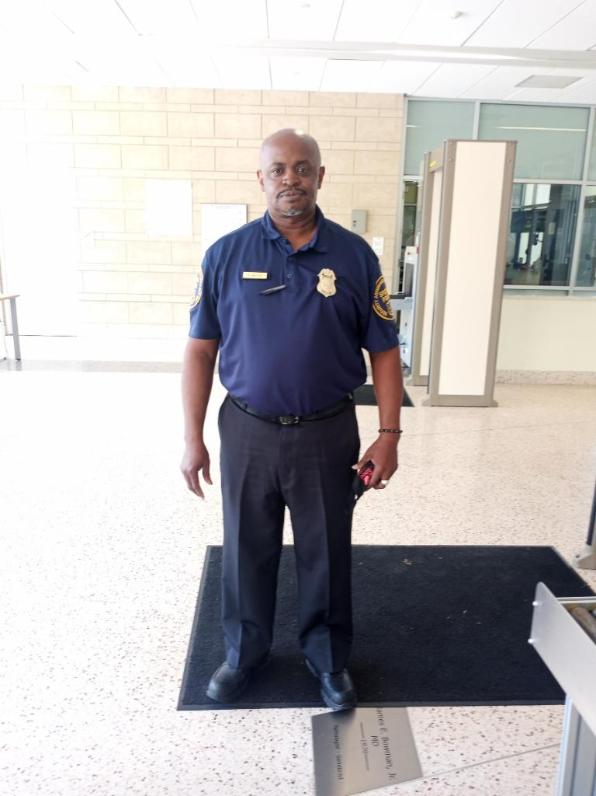
DCPS Contract Security
School Security Division
Security Assurance Mgmt.
School Officer (SO)
School Officer ( SPO)

Slide 11
Contract Officers Core Functions
School Security Division
Standard Operating Procedures – A copy will be shared with Principal and MSL/DSL
Observe and report
Prescribing authority only within and around buildings;
Operate off post orders: patrol hallways, stairwells, and conduct perimeters checks;
Maintain a safe and secure environment conducive to learning;
Manage weapons abatement stations (Secondary Schools only);
Collaborate with Student Support POC’s to de-escalate incidents;
Work in partnership with School Leadership, DCPS Police, and MPD.
Notes:
Highlight the

Slide 12
Dismissal and Aftercare
School Security Division
Not responsible for handing students off to parents during early dismissal
Not responsible for sitting with or watching students that are picked up late
Follow school specific protocol to ensure that a school-based staff member is responsible for dismissing students to parents that are listed on the approved pick-up list.
For late pick-up school base staff should remain with students on site until parent has arrived.
After a considerable amount of time, if the parent has not picked up student(s) please alert MPD, CSFA, and DCPS Command Center (202-576-6950).
Contract Security should complete an incident report and make appropriate communication to their captain.
Notes:
Highlight the

Slide 13
Post Orders
School Security Division
Like Standard Operating Procedures (SOP’s) but for Contract Officers
Detailed information on officer's whereabouts
Determined by Principal and/or Designee
MUST be reviewed, approved, and signed by Principal or Designee
Copy of post orders should be kept at the school (officers' desk)
Living and breathing document

Slide 14
Incident Reporting
School Security Division
When incidents occur, follow district and school-based guidance;
Contract security should be notified IMMEDIATELY;
Contract Security Officers are REQUIRED to write incident reports;
All incident reports should be completed by EOD;
If MPD is involved, include Central Complaint Number (CCN#)*;
Scanned and emailed to School Security team;
Incident reports are legal documents and cannot be shared externally;
Notes:
IF NO CCN# PLEASE SEND ANYWAY
DCPS is the client and we are responsible for developing security policy and standards in collaboration with MPD.
MPD controls the administrative process, including reviewing invoices submitted by contractor and processing payments, ensuring that all posts are covered, adding or deleting guard coverages, addressing DCPS Concerns with contractor and resolving any disputes with contractor.

Slide 15
The Incident Report
School Security Division
Notes:
Follow Emergency Response Plan.
IF NO CCN# PLEASE SEND ANYWAY
DCPS is the client and we are responsible for developing security policy and standards in collaboration with MPD.
MPD controls the administrative process, including reviewing invoices submitted by contractor and processing payments, ensuring that all posts are covered, adding or deleting guard coverages, addressing DCPS Concerns with contractor and resolving any disputes with contractor.

Slide 16
The Incident Report
School Security Division
Notes:
Follow Emergency Response Plan.
IF NO CCN# PLEASE SEND ANYWAY
DCPS is the client and we are responsible for developing security policy and standards in collaboration with MPD.
MPD controls the administrative process, including reviewing invoices submitted by contractor and processing payments, ensuring that all posts are covered, adding or deleting guard coverages, addressing DCPS Concerns with contractor and resolving any disputes with contractor.

Slide 17
The Incident Report
School Security Division
Notes:
Follow Emergency Response Plan.
IF NO CCN# PLEASE SEND ANYWAY
DCPS is the client and we are responsible for developing security policy and standards in collaboration with MPD.
MPD controls the administrative process, including reviewing invoices submitted by contractor and processing payments, ensuring that all posts are covered, adding or deleting guard coverages, addressing DCPS Concerns with contractor and resolving any disputes with contractor.

Slide 18
Contract Officers Support
School Security Division
ALL DCPS Activities
Before Care Programming
Regular Instructional School Day
After Care Programming
Special Activities
Athletic Events
Community Events

Slide 19
Questions pertaining to Contract Security ? Contact Us!
School Security Division
contractsecurityrequests@k12.dc.gov
Mr. Kalyn Blueitt
Ms. Michele Salahuddin
Ms. Pamela Floyd

Slide 20
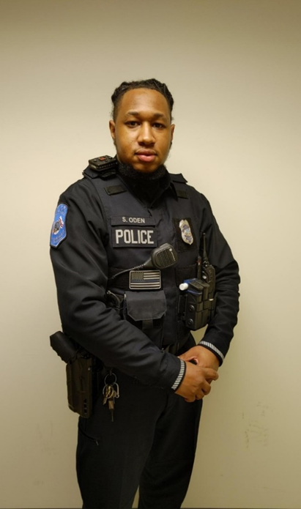
DCPS Special Police
School Security Division
DCPS Special Police Officer (SPO)

Slide 21
DCPS School Police
School Security Division
20 Officers
Commissioned by DCRA and MPD
Armed Special Police Officers – DC Government
Arrest Authority throughout DCPS Properties and Events
Certified Police Officers
DCPS Law Enforcement Officers
On duty 24/7/365

Slide 22
DCPS School Police
School Security Division
Supplement Contract Security Officers in schools and support MPD School Resource Officers with law enforcement and security related calls
Serve Barring Notices
Mediation Support
Safe Passage
Before Hours
After Hours

Slide 23
DCPS School Police
School Security Division
Locker Searches
Weapon Abatement
Training
Penetration Tests
Contract Compliance
Site visits
Certified Crisis Intervention Officers (MPD/DBH)

Slide 24
Support from DCPS School Police
School Security Division
Crisis Intervention
Physical Altercations with injuries
Mediations
Special Attention Requests
Safe Passage Concerns
Serve Barring Notices
Building sweeps
Alarm Response/Issues (FA/IDS)
Community Events/Meetings
Athletic Events
School Building Vandalism
School closing/opening assistance

Slide 25
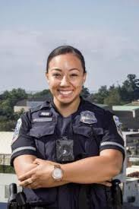
Partner Police Agencies
School Security Division
Metropolitan Police Department (MPD)
Metro Transit Police Department (MTPD)
MPD School Resource Officer (SRO)
MTPD School Resource Officer (SRO)

Slide 26
Letter of Instruction / Warning Letter
School Security Division
Letters of Instruction / Warning Letters are to be used as a tool to assist the School Community in guiding, curving, or stopping behaviors of parents, guardians, or authorized adults' designee.
- Similar to Progressive Discipline used for students
This letter can be used when the actions do not arise to the level of a Barring Notice or as a step prior to the request of a Barring Notice.

Slide 27
Letter of Instruction / Warning Letter
School Security Division
Letters can be used in the following instances (not an all-inclusive list):
A person has attempted to disrupt school activities, school events, or classroom instruction.
A person has made unsubstantiated verbal threats or threatening behaviors.
A person has attempted to cause destruction to school property.
A person violates school-based rules / policies.

Slide 28
Letter of Instruction / Warning Letter
School Security Division

Slide 29
Barring Notices
School Security Division
Principals are granted authority by the Chancellor to request permission to deny a person’s request to enter a school building or to be present on school premises in the following instances:
A person has attempted to disrupt educational environment.
A person poses, has posed, or attempted to pose a threat to any student or staff or otherwise compromise student or staff safety.
A person has endangered or intentionally caused destruction to school property.

Slide 30
Examples
School Security Division
Physical assault on staff, student, or third party
Verbal threats to members of school community
Causing or inciting a fight among staff or students
Theft or vandalism committed on school property
Possession of weapons on school property
Possession of illegal drugs on school property
Repeated instances of behavior that cause a disruption to school operations/events

Slide 31
Barring Notices
School Security Division
Used as a last resort
Should not to be used as punishment
Cannot exceed the current school year
Can be served in person or by mail

Slide 32
Examples of Less Restrictive Measures
School Security Division
Verbal Redirection
Parent Conference
Mediation with DCPS Grievance Team
Warning Letters – warning letters should be the last measure attempted before requesting a barring notice. Principals can draft warning letters on their own without going through any approval process. OGC is available to review letters, but it is not required.

Slide 33
School Closing Protocols
School Security Division
Conduct an interior check, two (2) hours prior to closing building
Check all doors and windows
Arm the intrusion detection system (IDS)
Notify the command center prior to leaving
Ensure that all closing parties exit out of one identified door.

Slide 34
When to call 911, 311 or Command Center
School Security Division
911 is to be use for EMERGENCIES ONLY
- Crime in progress
- All fire and Medical
311 is to be used for NON-EMERGENCIES
- Text NEW or MENUE to 32311 (DC311)
Command Center: 202-576-6950
- Whenever you call 911 0r 311

Slide 35
Thank you! Questions?
School Security Division
Command Center (202) 576-6950
Michael Alston, Captain: Michael.alston@k12.dc.gov
Brian Johnson, Lieutenant: Brian.johnson2@k12.dc.gov
Corneilus Johnson, Lieutenant : Corneilus.johnson@k12.dc.gov
Ronald Bogues, Lieutenant: Ronald.bogues@k12.dc.gov

Slide 36
Physical Security
School Security Division
Physical Security Manager, Franklin “Skip” Chrisman
Franklin.Chrisman@k12.dc.gov
Michael Berry,
Michael.Berry@k12.dc.gov

Slide 37
Physical Security
School Security Division
Responsible for procurement and maintenance of all physical security equipment in DCPS.
Control and maintenance of over 8,652 camera in 118 schools and DCPS properties
Manages Fire and Intrusion alarms
Works with MPD, DGS and other district agencies to secure schools.
Maintain school weapons abatement equipment:
X-Ray machines
Metal detector

Slide 38
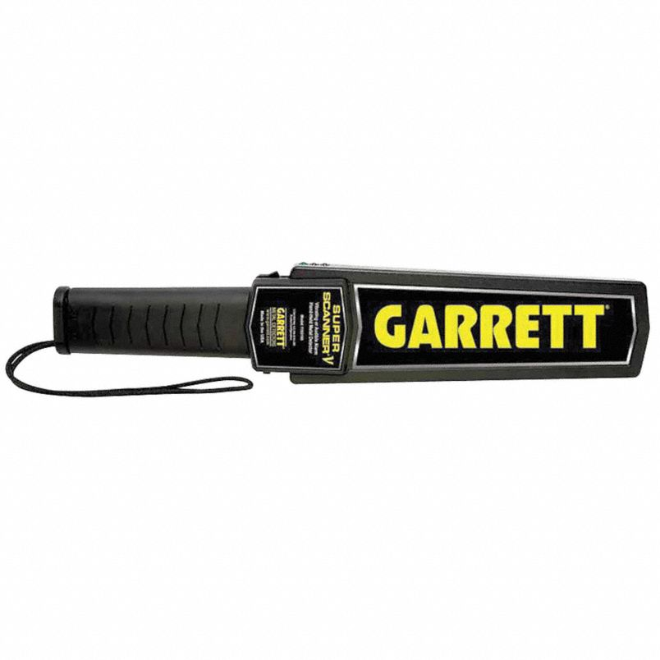
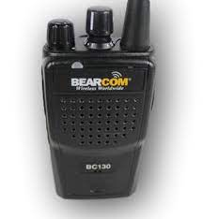
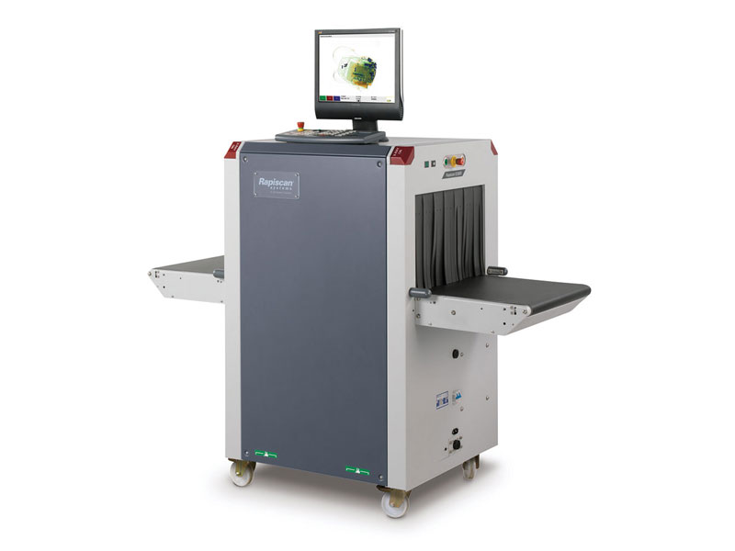
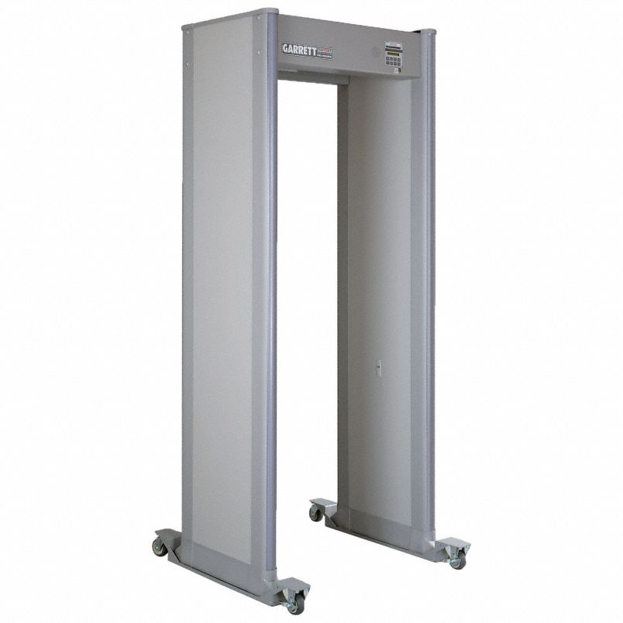
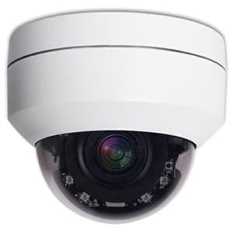
Physical Security Equipment in Schools
School Security Division
School Security Division: Physical Security

Slide 39
Equipment Totals
School Security Division
Walkthrough Metal Detectors - 76
Hand wands - 135
X-Ray Machine - 76
DCPS Security – 22
Contract Security - 210
Cameras - 8,652

Slide 40
Elementary Schools
School Security Division
Door phone
Cameras
Camera monitor(s)
Intrusion alarm system
fire alarm system
Access control systems

Slide 41
Secondary Schools
School Security Division
X-ray machines
metal detectors
hand wands
door phones
cameras
camera monitor(s)
intrusion/fire alarm systems
access control systems

Slide 42
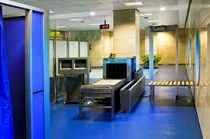
Caring for your Equipment
School Security Division
X-Ray machines must be wiped down with disinfectant daily prior to use.
NO liquid should be placed on the x-ray machine.
If a machine is not working, please notify the team immediately.
franklin.chrisman@k12.dc.gov
Michael.Berry@k12.dc.gov

Slide 43
Caring for your Equipment
School Security Division
Work orders are only called in to DGS for the following:
Intrusion/Fire alarm system
Access control systems (fobs/swipe cards)
All other requests for maintenance goes to the contractor
Camera’s & Door phones (Vision)
X-ray Machines (Rapiscan)
Metal Detectors (Garrett/DCPS)

Slide 44
How to care for Metal Detectors
School Security Division
A work order is not required.
Causes of Outages: Plugs, Damage and Cords

Slide 45
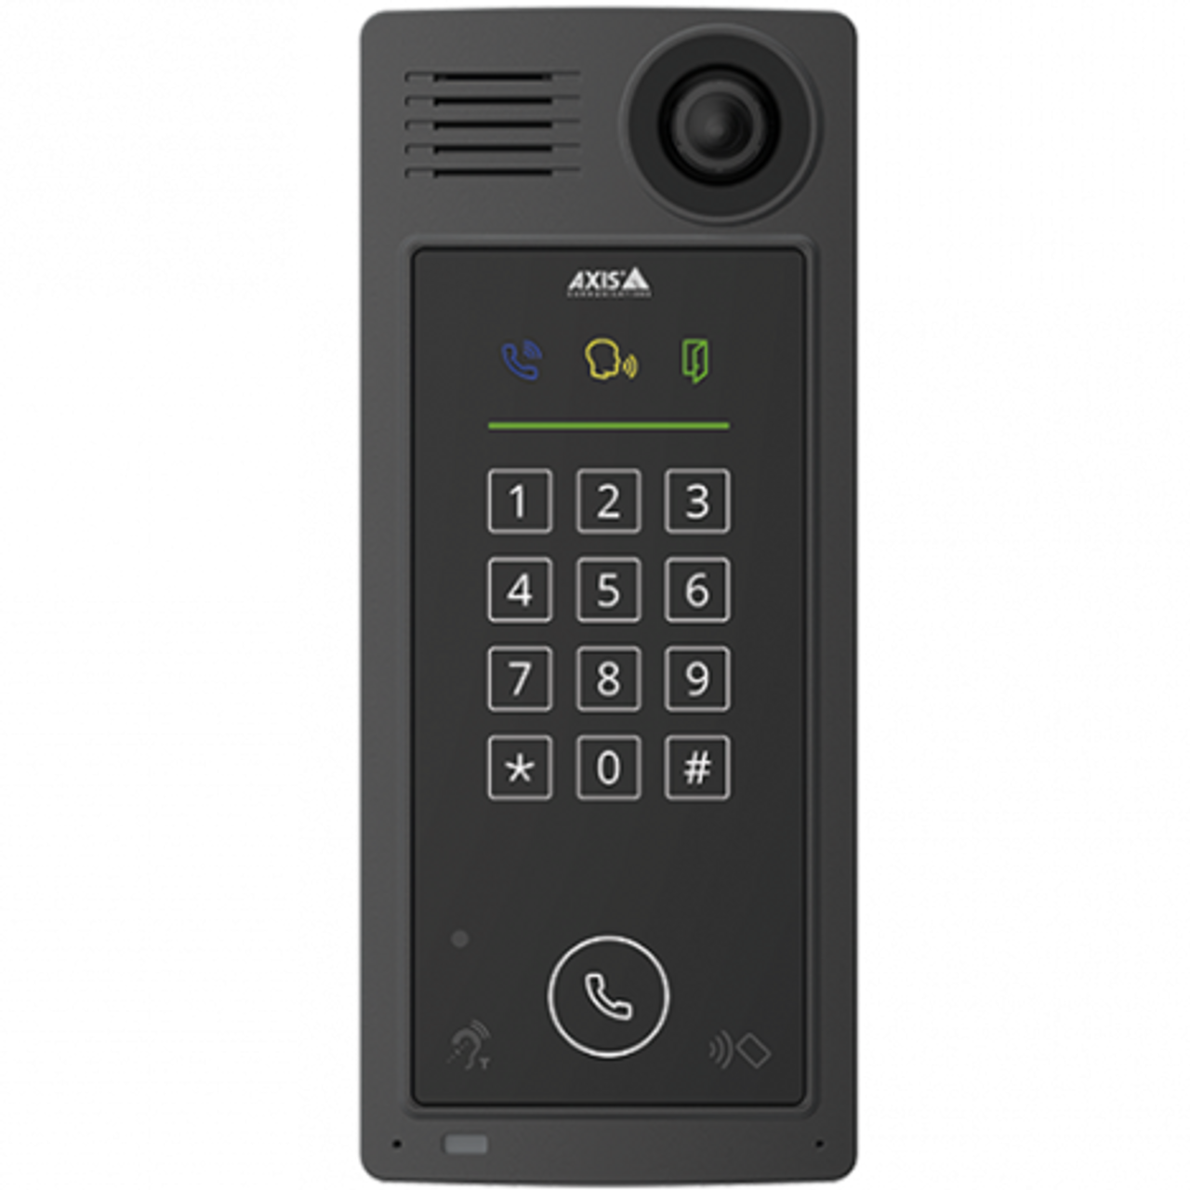
How to care for Door Phones
School Security Division
A work order is not required.
The contractor will be notified.

Slide 46
How to care for CCTV Cameras, Monitors and Servers
School Security Division
Report all CCTV cameras, monitor outages and server to the Physical Security Team.
The contractor is notified, and it is usually same day service unless a part or cameras have to be ordered
AC for Camera Servers

Slide 47
How to care for X-Ray Machines
School Security Division
Report all X-ray machine outages to the Physical Security Team.
Check the Stop Buttons
Check the curtains (Radiation)
Check the Plugs
Make sure the Monitor is turned ON and Plugged into outlet

Slide 48
CCTV VIDEO ACCESS
School Security Division
Three (3) Staff Members from each school. Designated by the Principal
SAM Security Guards

Slide 49
Requesting Video Footage
School Security Division
Identify the date
beginning and ending times
cameras numbers
Send Request to Franklin.Chrisman@k12.dc.gov or Michael.Berry@k12.dc.gov
Also, MPD can come to the school and review cameras if they need any video.

Slide 50
School Security Division
Video footage is not to be recorded on personal devices or shared with the public by any means.

Slide 51
CCTV Footage
School Security Division
Video footage should not be released without the proper authorization.
The law requires DCPS to withhold release of or access to video footage showing minor children for privacy reasons since DCPS lacks the technical capacity to blur images of minor children. Video footage containing images of minor children and other individuals is only released by DCPS pursuant to law enforcement request, subpoena, or court order. However, if the footage is used to support student disciplinary action and becomes an education record, DCPS and the Office of Administrative Hearings provide for footage to be shown during the hearing as evidence, but parents are not entitled to retain a copy of such footage.

Slide 52
Thank you .. Questions?
School Security Division
Franklin “Skip” Chrisman 202-373-4578 Franklin.Chrisman@k12.dc.gov
Michael Berry 202-373-4614 Michael.Berry@k12.dc.gov

