Slide 1
Disability Continuum
How It Shows Up In The Classroom

Slide 2
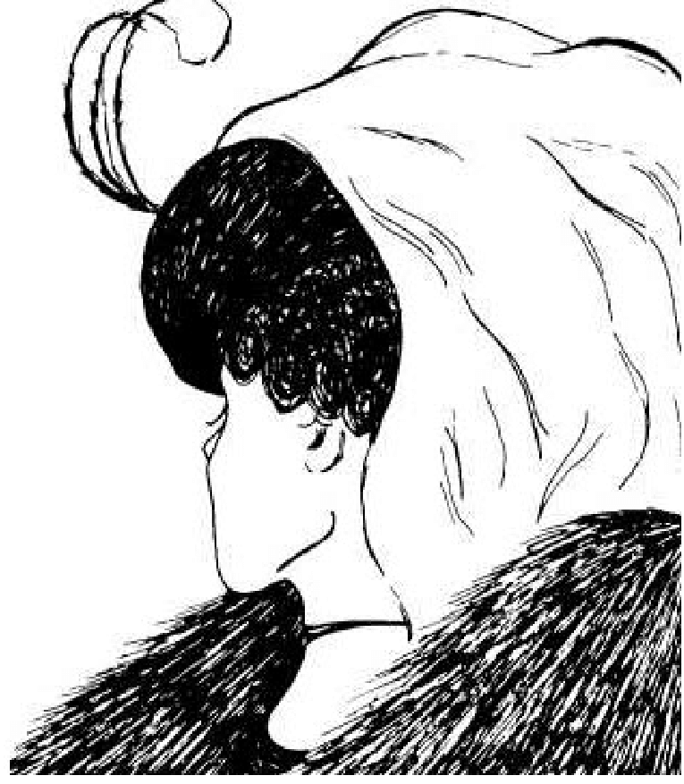
Activity: What do you see?

Slide 3
Activity: What do you see?

Slide 5
Statistics
According to the US Census Bureau:
The percentage of children with a disability in the United States increased between 2008 and 2019, from 3.9 percent to 4.3 percent
The most common type of disability among children 5 years and older in 2019 was cognitive difficulty
About 1 in 6 or 17% of children ages 3-17 in the US have one or more developmental disabilities

Slide 6
What is a Disability?
A disability is any condition of the body or mind (impairment) that makes it more difficult for the person with the condition to do certain activities (activity limitation) and interact with the world around them (participation restrictions).
There are many types of disabilities, such as those that affect a person’s:
Vision
Movement
Thinking
Remembering
Learning
Communicating
Hearing
Mental health
Social relationships

Slide 7
What is a Disability?
Disability has three dimensions:
Impairment in a person’s body structure or function, or mental functioning; examples of impairments include loss of a limb, loss of vision or memory loss.
Activity limitation, such as difficulty seeing, hearing, walking, or problem solving.
Participation restrictions in normal daily activities, such as working, engaging in social and recreational activities, and obtaining health care and preventive services.

Slide 8
13 Disability Categories Under IDEA
Specific Learning Disability
Autism
Other Health Impaired
Emotional Disturbance
Speech and Language Impairment
Visual Impairment, including blindness
Hearing Impairment
Deaf Blindness
Deafness
Orthopedic Impairment
Intellectual Disability
Traumatic Brain Injury
Multiple Disabilities

Slide 9
Disability and IEPs
Every student that has a disability does have an IEP(Individualized Education Plan)
IEPs are created based on the student's ability to access
What is the greatest level of impact and what services are needed to support the student?

Slide 10
Justina Miles

Slide 11
Executive Functions in the Brain
Executive Functioning
Notes:
Executive Function Skills are "Brain-based" Skills required for humans to effectively execute or perform tasks and solve problems.
[READ the SLIDE][Give the Color Section and READ the function & Demonstrate on Self – in head]
I have a MS in Developmental Psychology and Physical Therapy. As a Physical Therapist, I knew if a person was injured in a certain part of the brain, what was impacted like vision]
This has been become a Wendy Williams Hot Topics in sports like football and boxing with CTE Injuries.
The brain degeneration is associated with common symptoms of CTE including memory loss, confusion, impaired judgment, impulse control problems, aggression, depression, suicidality, parkinsonism, and eventually progressive dementia.
Chronic Traumatic Encephalopathy (CTE) is a progressive degenerative disease of the brain found in people with a history of repetitive brain trauma (often athletes),
The brain’s frontal lobe that controls our executive functions, but does not fully develop until our mid-20s between 20 – 25 years of age.
So when see Instagram posts, Facebook or You Tube posts, of our teenagers or college kids doing – what my mom calls, "dumb things"… we know why, lol.
Although these neurological skills required to perform these executive functions are not often fully developed in adolescents, these skills can be improved with practice and targeted strategies.
But they must be coordinated in our brains to "execute" complex tasks through to completion.

Slide 12
Distractability vs. Attention Span
Distractabilty Attention Span
Pays attention to everything
Overstimulation
Attention is easily diverted
Does not pay attention to details
Easily disengages from the activity
Focus is limited

Slide 13
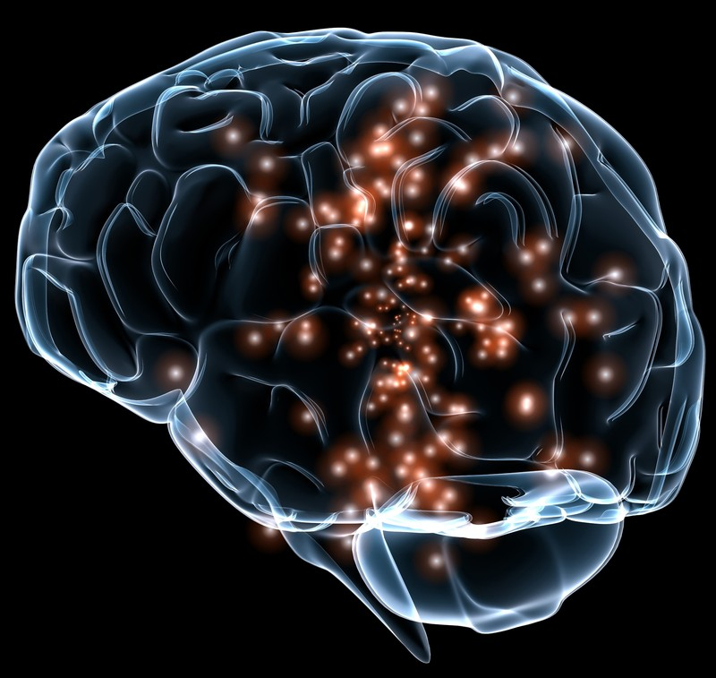
Processing
Takes a long time to process information
Poor memory when recalling information
Difficulty with remembering oral instructions
Notes:
The student may not go into full detail or give a robust answer but may give a general idea of understanding, which is a good place to start. Many students are functioning at a 3rd grade but are in the 11th grade

Slide 14
Elizabeth Bonker

Slide 15
Activity
Mind Field

Slide 16
Reflection

Slide 17
Let's Connect!
Crystal Millington
Program Manager, Behavior Learning Supports
2027315571
crystal.millington@k12.dc.gov

