Slide 1
Infused with Joy: Afterschool Academic Power Hour August 2023

Slide 2
Agenda
Academic Power Hour in Practice
Introduction
Overview of Teacher Role
1 hour of Joyful Learning
Resources for APH
Questions

Slide 3
Introduction
The DCPS 21st CCLC grant has a set of objectives related to the outcomes we achieve:
90% average daily attendance in PK-Grade 5 and 75% in Grade 6-8.
40% of regular program attendees will make gains in classroom grades from fall to spring.
10% of regular program attendees will increase at least one proficiency level on ELA and math state assessments.
75% of regular program attendees will show improvement from Fall to Spring in classroom behavior and attentiveness.
A cumulative of 60% of student program participants' family members will attend at least three program events as measured by attendance logs and surveys.

Slide 4
Teacher’s Role in Afterschool
Plans lessons and activities that meet the academic needs of all students
Uses various resources to enrich student learning
Monitors student progress and needs
Active engagement
Collaborates with student’s daytime teachers to drive student success
Follows all expectations outlined in staff handbook

Slide 5
Academic Power Hour Structure
1 hour of Joyful Learning
3:30-4:30*
Literacy | Math | Homework
20 minutes Read aloud Scholastic News Magazine Skill building Book Club Drama Club Comic Book Day Newspaper Club Sing a longs | 20 minutes Digital resources Bridges Drills Games Math story problems Math crafts Math songs | 20 minutes Small group support Student helper Whole group examples Start at school, finish at home
*at most schools APH will be from 3:30-4:30 or 3:45-4:45 depending on snack schedule.

Slide 6
How can YOU incorporate JOY into APH?

Slide 7
APH Resources

Slide 8
APH Resources
https://www.mathlearningcenter.org/curriculum/free

Slide 9
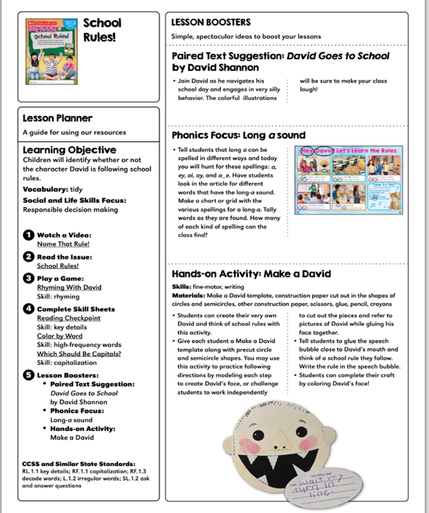
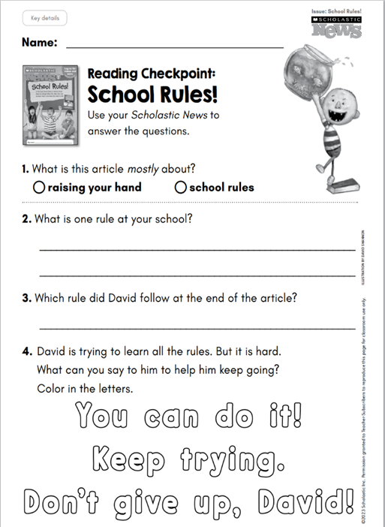
APH Resources

Slide 10
No Homework, No Problem
How can you support multiple grade levels?
The resources below are from the Bridges Math Intervention curriculum
1st Grade
2nd Grade
3rd Grade

Slide 11
Questions? Thoughts? Ideas?

